Slide 1
Personal Project:
WELCOME Parents!
A General Introduction
Thomas Jefferson High School
2019-2020

Slide 2
OBJECTIVE THE BASICS… -What is the Personal Project? -What do I have to do?

Slide 3
What is the Personal Project?
An opportunity to demonstrate specific SKILLS students have gained in the IB programme as they end the last year of MYP, year 5.
Gives students the opportunity to engage in something they feel is valuable!
An independent assignment on ANY topic & can take on ANY form!

Slide 4
Let’s look at the awesome outcome of an Exhibition Night!
Notes:
https://youtu.be/Etk7T_sKbhY

Slide 5
What sort of Personal Project CAN they do? (Whatever they can think of?)
Organize charity events
Create websites on topics you feel are significant
Design 3 D models / products (like building a violin)
Create a video to share information or help with an issue
Paint a mural to increase awareness of an issue
Create a cookbook designed to help people eat more fruits and vegetables
Create a collection of poems or short stories
Fix a problem or make something better

Slide 6
What student’s can NOT do and will NOT work
A copied and pasted cookbook found on the internet (no effort/possible plagiarism issues)
Find a way to solve the debt of Tanzania (not accomplishable)
Find out about violence in sports (not specific enough)
Build a skateboard from parts that you can buy (too easily accomplished).

Slide 7
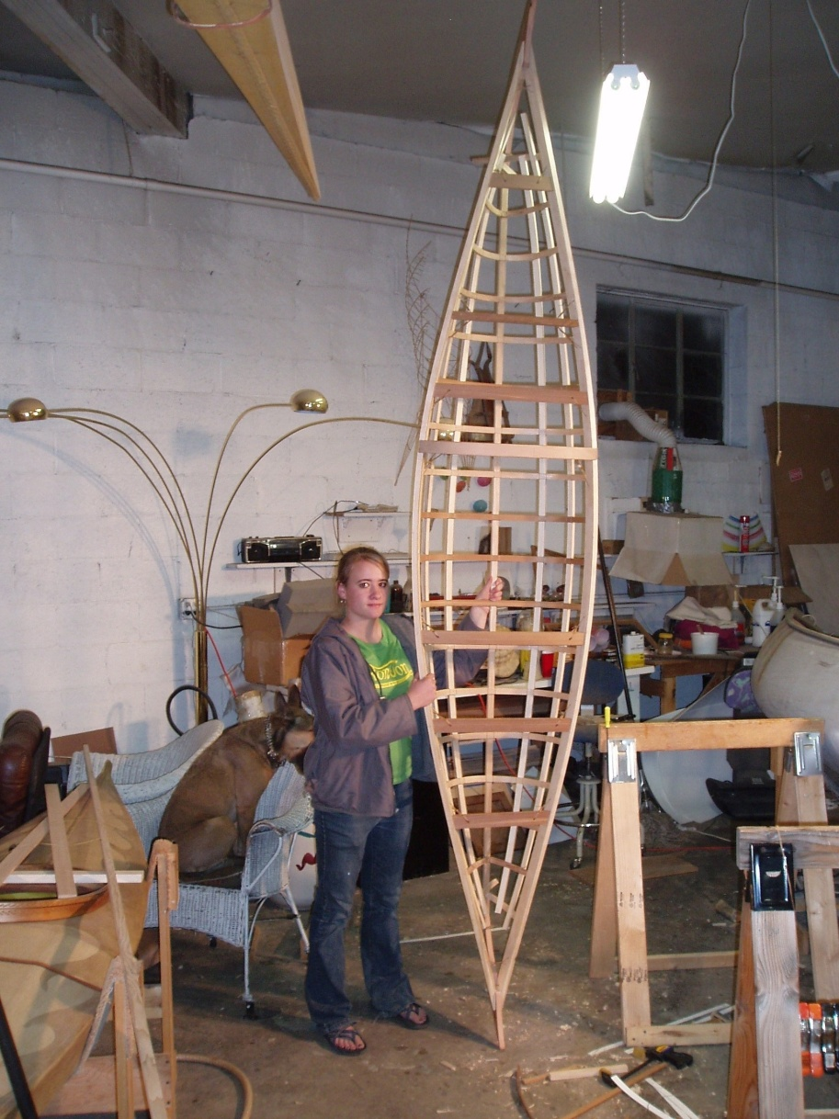
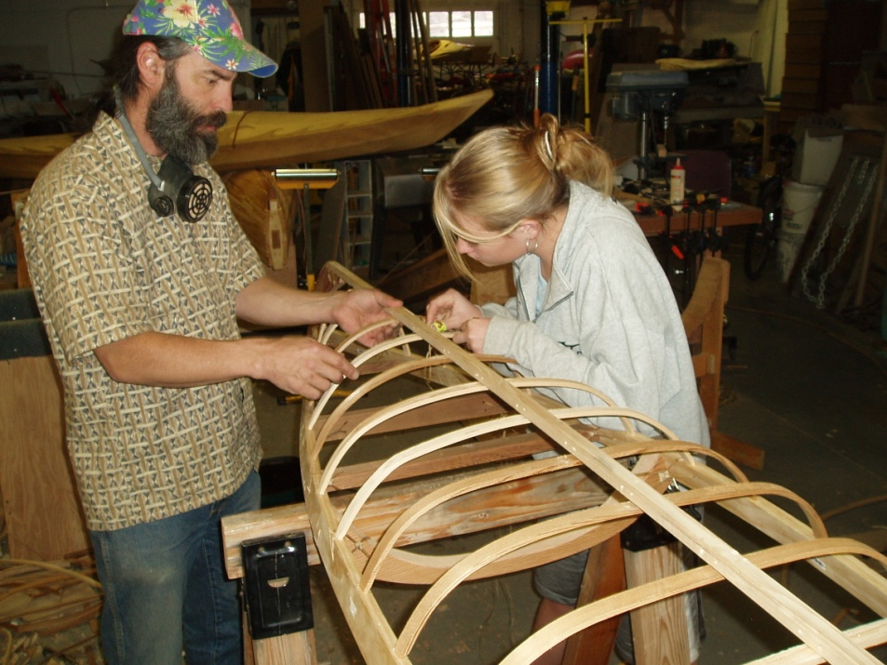
Awesome photos of REAL projects:
Building a full-scale Inuit Kayak out of wood, w/o using glue or metal

Slide 8
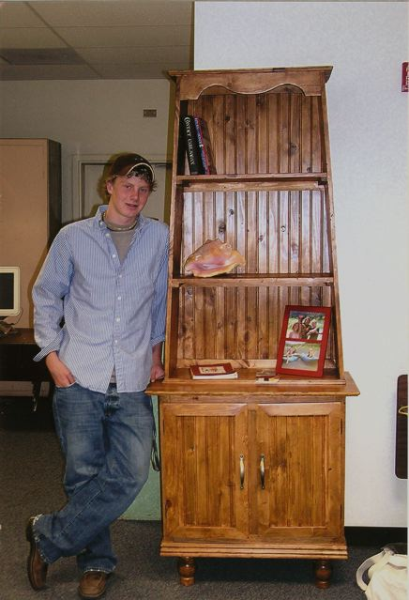
Awesome photos of REAL projects:
Building a piece of furniture out of wood

Slide 9
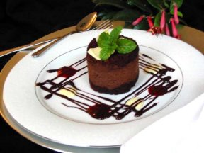
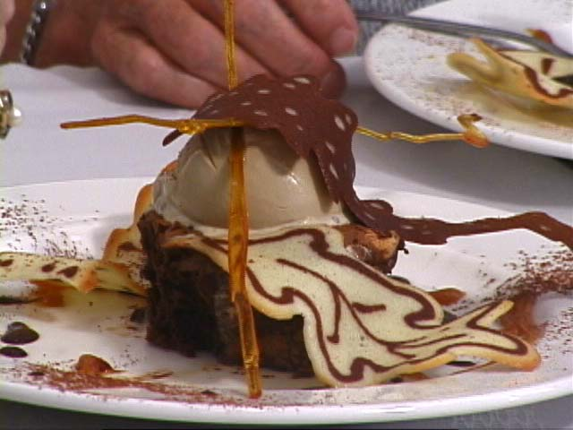
Awesome photos of REAL projects:
Learning how to cook gourmet chocolate desserts

Slide 10
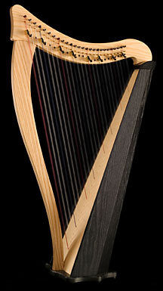
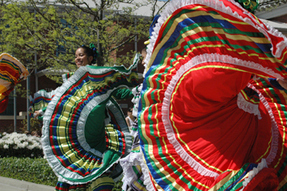
Awesome photos of REAL projects:
Learning how to dance, or sing, or play an instrument

Slide 11
Notes:
https://youtu.be/DCp6lZvoaok

Slide 12
Notes:
What is MYP?? Just a framework in which we build with best teaching practices
Things to get authorized are indicated in our standards.
There are 3 Main category Standards with multiple strands, A,B, and C totaling 7
A= Philosophy
B= Leadership & Structure
C= Curiculum

Slide 13
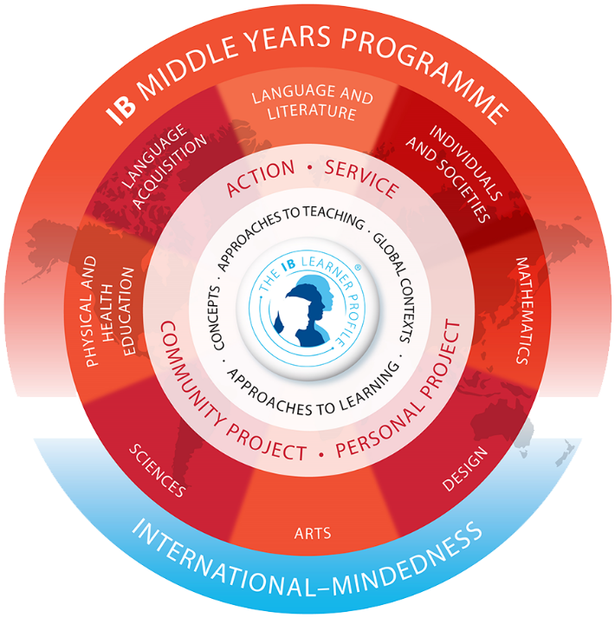
The Personal Project requirement for ALL 10th grade students
Who Are Students!?
MYP 9th & 10th

Slide 14
WHY do we do the Personal Project?
Doing things because you are curious, motivated, interested is at the CORE of life-long learning!
Practice and demonstrate your skills on a topic you care about:
Research & information literacy
Self- and Time-Management
Thinking
Communication
Social
Reflection

Slide 15
Why do students like the Personal Project?
This may be your one and only chance to do what you want to do, not what teachers tell you to do!
They get to “teach the teacher.”
They can showcase their work in an exhibition.
They can see other projects and see what their friends did.
They will be able to work with mentors outside of school.
They will be able to develop a better relationship with their teachers and supervisors.
IF a MAGNET student, this will help them hone their skills for the extended essay (Diploma Program).

Slide 16
General Parameters of the Project
Please note again that ALL 10th STUDENTS WILL COMPLETE A PERSONAL PROJECT, regardless if students are magnet or not
The IB programme REQUIRES at least 3 meetings with their supervisor (once at beginning of project, once near the mid-point, and once near the end). Students will record these meetings on the REQUIRED Academic Honesty Form and acquire the necessary signatures.
Attendance at Exhibition Night is MANDATORY for all students. For the 2019-2020 MYP Personal Project students, the date will be Friday, March 20.

Slide 17
General Parameters of the Project (What students HAVE to do…)
Students are expected to spend about 25 hours total (for ALL things related to the Project)
Demonstrate development in the ATL Skills
Document their experience in a PROCESS JOURNAL (ManageBac)
Collaborate with their SUPERVISOR
Have a GOAL, GLOBAL CONTEXT, and PRODUCT/OUTCOME
Conduct RESEARCH
Create their own CRITERIA
Develop a PLAN OF ACTION
Create a REFLECTIVE REPORT of their experiences
Meet expected deadlines; they will count for a grade (quarterly)

Slide 18
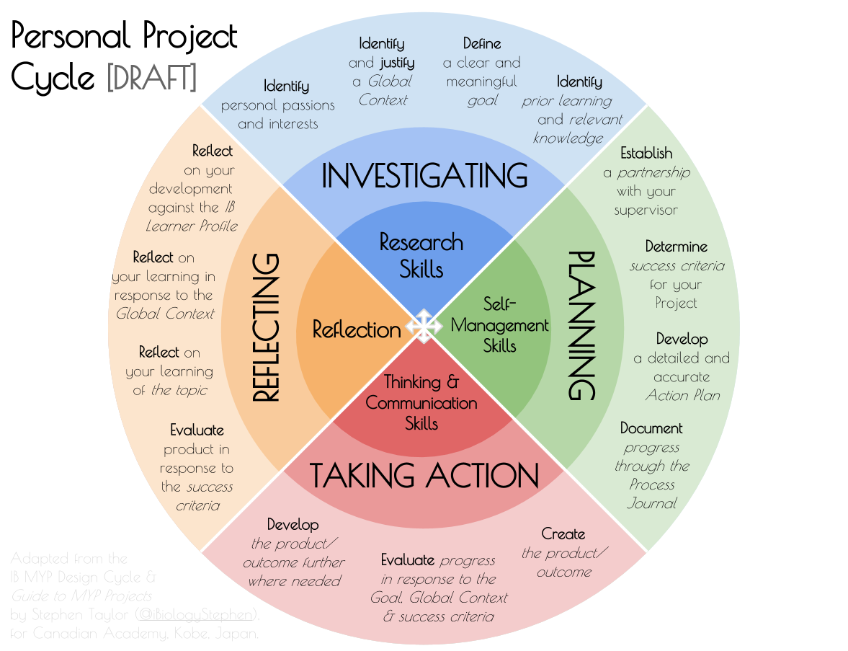
Notes:
At the center of the circle you will find the ATL (approaches to learning) skills; they are soft skills that have to be explicitly taught to students. Our campus will be utilizing the AVID & Money Matters courses to teach these skills to our kids.
Now looking from inside out, your will see the criterion/objectives (two words used interchangeably) that student will be graded on.
Objective/Criteria (these line up with the Aims of the project)
Objective A: Investigative
Objective B: Planning
Objective C: Taking Action
Objective D: Reflecting
Along the outer edge you will find the “strands” that go under each objective. Strands line up with drive & motivation for students to complete the personal project.
Again they will be explicitly taught to the students with Coach Montalvo, Coach Beresford and Coach Sandoval who teacher AVID & Money Matters.

Slide 19
ATL SKILLS (important!)
ATL Skill Categories | MYP ATL Skill Clusters
Communication | I. Communication
Social | II. Collaboration
Self-Management | III. Organization
 | IV. Affective
 | V. Reflection
Research | VI. Information Literacy
 | VII. Media Literacy
Thinking | VIII. Critical Thinking
 | IX. Creative Thinking
 | X. Transfer

Slide 20
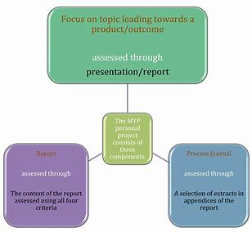
Product
Process Journal
Report
Notes:
Students complete three elements: 1. product or outcome—evidence of tangible or intangible results: what the student was aiming to achieve or create 2. process journal-- ideas, criteria, developments, challenges, plans, research, possible solutions and progress reports 3. report—an account of the project and its impact, which includes a bibliography and evidence from the process journal that documents students’ development and achievements. Supervisors ensure that each personal project is complete.

Slide 21
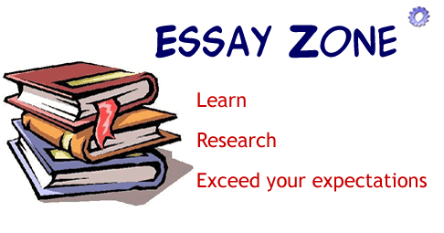
A PRODUCT OR OUTCOME
an original work of art -piece of creative writing- a novel,
a collection of short stories, a song
a sculpture
a model
a business plan e.g. How to help Croatia get out of the recession?
a campaign
a blueprint or drawing
an essay (scientific, litereary or other)
a video/computer game,website
a course of study e.g. How to play a in 4 months? How to learn in 3 months?
a film/video
etc.

Slide 22
The Process Journal
Use ManageBac - It’s a GREAT place to store everything – reflection, research, sources, etc. (No fear of losing your work!)
They can add journals entries, files, websites, photos, etc.
Consistent entries are an absolute necessity from all CRITERION A-D!
Use this as supporting evidence for development of ATL skills when writing your reflective report
Students can include up to 10 excerpts along with their report to support assertions made in the report

Slide 23
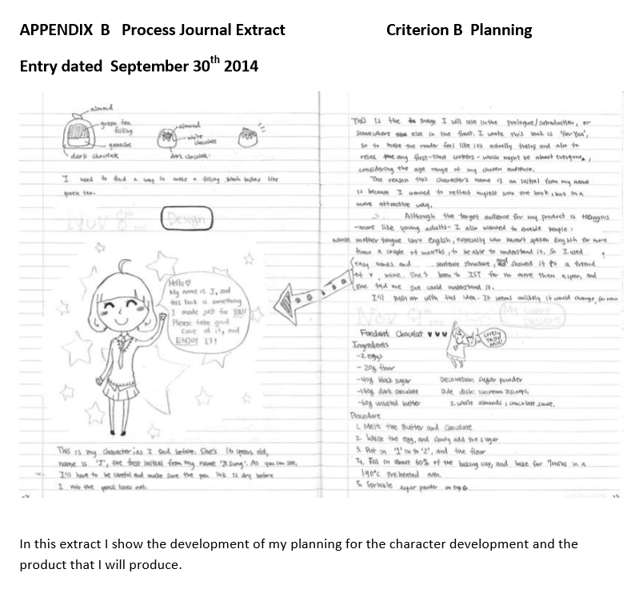
Process Journal: Criterion B

Slide 24
Process Journal: Criterion C

Slide 25
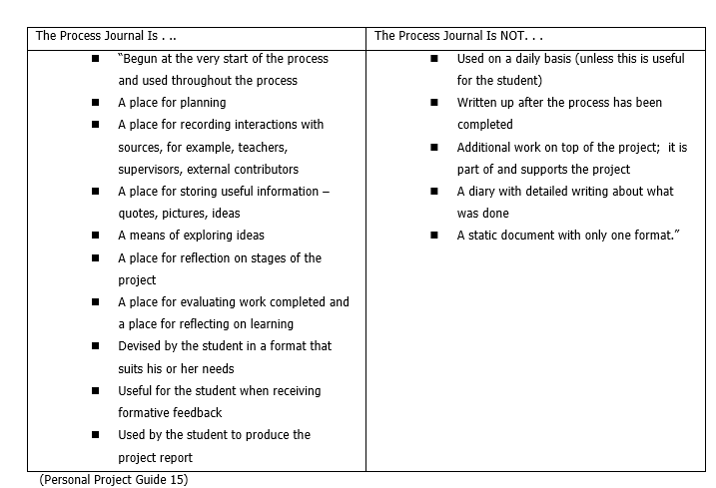
The Process Journal

Slide 26
The REPORT

Slide 27
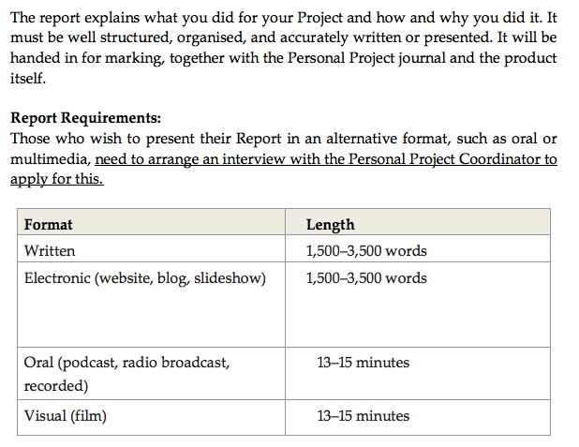
The REPORT

Slide 28
THE PHASES OF THE PROJECT…

Slide 29
Phase 1: Topic, Goal, Product/ Outcome, Global Context, Begin Process Journal Entries, Supervisor
Choose a topic and develop a highly challenging goal!
Develop a product/outcome based on that goal
Choose ONE Global Context to guide your project
Begin entries into ManageBac about the process, make references to the ATL skills
Meet their supervisor

Slide 30
Samples of highly challenging goals
Outline a BASIC & appropriate goal | Define a clear and CHALLENGING goal | Define a clear and HIGHLY CHALLENGING GOAL
To design my own electric violin | To research violin design and making, and then design my own electric violin | To research violin design and making, then design and produce my own 4 or 5 stringed electric violin
To design my own summer clothing collection | To research current fashion trends and then design my own summer clothing collection | To research current fashion trends and how to design patterns. Then design and create a summer clothing collection and then learn how to create a “template website” to market my designs
To raise $400 for the education of an Indonesian child | To sponsor an Indonesian child to university for 4 years by raising $1500 | To volunteer at the International Humanities Foundation over the Christmas holidays and then raise $1500 to sponsor an Indonesian child to university for 4 years
To donate money to a school in Bali | To raise money for a school in Bali and then donate the money raised for the school | To research schools in Bali and then raise money to purchase stationery for the school to support student education

Slide 31
Global Contexts: Choose only ONE!
Global Context | Examples of Personal Projects
Identities and relationships | • Two sides of social networking; an awareness campaign about digital citizenship and cyber bullying
Orientation in space and time | • Charting a family history through archives and a representational statue
Personal and cultural expression | • Video games as a form of cultural expression; a short film using five video games that shows how they are an expression of our culture
Scientific and technical innovation | • Can stem cells replace organ transplants?; an investigative report
Globalization and sustainability | • The struggle for water in developing countries; an awareness campaign
Fairness and development | • Open-market economies and their role in fair trade; a talk for students

Slide 32
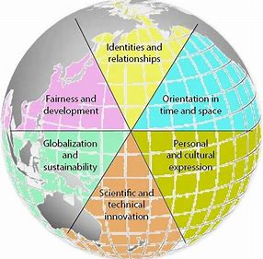
GLOBAL CONTEXT PROJECT IDEAS

Slide 34
Phase 2: The Plan of Action, Begin the Research, Criteria
Students will develop a plan to complete the project (like a calendar)
Research resources should be of a “wide variety”; the topic/goal/global context will drive your research
Students will develop their own rigorous criteria to assess the quality of their product/outcome

Slide 35
What Students Should Keep in Mind Through the ENTIRE Project
The IB Assessment Criteria/Rubric (They will need to write your project report using this rubric, since they will be assessed by it.)
ATL Skills (In their project report, they’ll need to demonstrate development in all 10 areas.)
The IB Learner Profile (In their project report, they’ll need to reflect on how they’ve developed as an IB Learner.)
ManageBac / The Process Journal (They’ll need to consistently write in the journal to help them keep track of what they’ve accomplished and which ATL skills are addressed. They will write their report from these entries and can include UP TO 10.)
A Supervisor (You will help guide them)

Slide 36
Supervisor
Each student will have a supervisor
Staff member at TJHS
Not necessarily a teacher they have had!
This person will assist and guide students through the project
Supervisors will also assess projects
The IB requires at least 3 meetings with the supervisor: one at the beginning stages of the project, one at mid-point, and one near the end

Slide 37
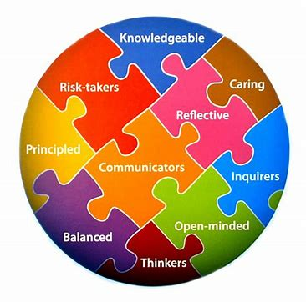
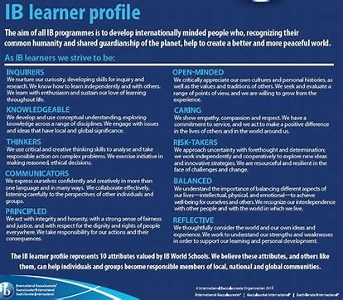
THE IB LEARNER PROFILE

Slide 38
ACADEMIC HONESTY
must be your own PP
must use the academic honesty attached to the PP Guide
failing to acknowledge your sources results in failing the PP
if you copy someone else’s PP you will be required to do a new one
the consequences of plagiarism and cheating are based on the school’s Book of Regulations and the Code of Conduct.

Slide 39
Phase 3: Product / Outcome & Project Report
Students should continue research on their project
Students will complete their product/outcome, then they will use their own criteria to evaluate their project
Students will complete their Project Reports

Slide 40
Assessment Criteria
Criterion A: Investigating
Define a clear GOAL and GLOBAL CONTEXT
Identify learning
RESEARCH skills
Criterion B: Planning
Develop your own assessment CRITERIA
Record the development process in a PLAN OF ACTION
Self-management skills
Criterion C: Taking Action
Create a PRODUCT / OUTCOME
Demonstrate thinking skills
Demonstrate communication and social skills
Criterion D: Reflecting
EVALUATE the product/outcome with your own criteria
Reflect on how the project impacted your knowledge
Reflect on how the project impacted you as an IB learner

Slide 41
Phase 4: The Assessment
Supervisors will meet to internally standardize the criteria (agree on what it means) and assess student projects
Assessment scores will be shared and discussed with students

Slide 42
Is help available if students get stuck?
Yes, of course! Go straight to these people for extra help!
Your Personal Project Supervisor
Teachers who have similar interests
Mr. De Leon, Ms. Young, Mr. Sandoval, Mr. M. Martinez, Ms. Rivas
Parents/Guardians
Community mentors

Slide 43
How will the project be scored?
Criteria | Description | Maximum Score
Criterion A | Investigating | 8
Criterion B | Planning | 8
Criterion C | Taking Action | 8
Criterion D | Reflecting | 8
Students can have a maximum score of 32 points.

Slide 44
Personal Project rewards
Grade in US History & English class!
Teacher recommendations!
Looks GREAT on High School Transcript!
Showcase to friends, family & community!

Slide 45
Phase 5: Exhibition Night
This is an opportunity for students to show off their accomplishments to their friends, family, and community!
Invited will be Elementary & Middle school feeders during day as well as Board members and District Personnel for evening!
They celebrate their accomplishments in MYP!
Attendance will be mandatory! They should want to show off your work!

Slide 46
SAVE THE DATE!
Exhibition Night will be:
Friday, March 20, 2020
in Armory

Slide 47
Communicating with Parents
The TJHS Mustang Messenger, (sent via email), and Family Engagement Nights are the main form of communication with parents for the Personal Project Initiation.
All dates for the project will be published on the school website calendar page.
Since this is a Personal Project, students need personal responsibility. We hope to foster personal responsibility through building relationships with advisees and supervisors.
Parental awareness is key to a successful project, not necessarily parental involvement. Signature pages may come home.

Slide 48
How can parents support their student?
Discuss possible topics with your student
Know the final selected topic
Be aware of the due dates through English class & History class.
Check in on progress
Read the process journal and report
Attend the showcase

Slide 49
FAQ
Q: What is the Personal Project?
A: It’s a project that all students do in the 9th and 10th grade. Students get to choose exactly what they want to do. It’s like a project fair that has more rigorous requirements than your average science fair.
Q: Does my student have to participate in this?
A: Yes, it is a requirement for students to pass on through the 10th grade to the 11th grade. It is also a major grade in English Language Arts classes and World History classes. It is not a graduation requirement because it is assessed in the 10th grade.
Q: How can I help my student?
A: This is a self-directed project, so students do most of the work. However, parents can and should facilitate their student’s success, whenever possible. Good ways of doing this include driving students to interviews and meetings, facilitating interactions with mentors, and making sure that there is time at home dedicated to the process journal.
Q: What is exactly is involved in a process journal?
A: Your student should be documenting his or her progress throughout the year with a process journal. A process journal is a diary of steps that your student has completed and goals that your student has proposed. A process journal also includes a superb proposal, source evaluation, meeting reflections & outcomes, and photos

